Slide 1
End Semester Presentation

Slide 2
Learnings
Initial Knowledge Transfer
Understand about how Omeka works and how to perform operations like upload a file
Debugging the errors the faced during pdf upload in Omeka
Desiging website using Figma
Learned about Reactjs
Stylizing the website using bootstrap
Responsive Website
Data Parsing

Slide 3
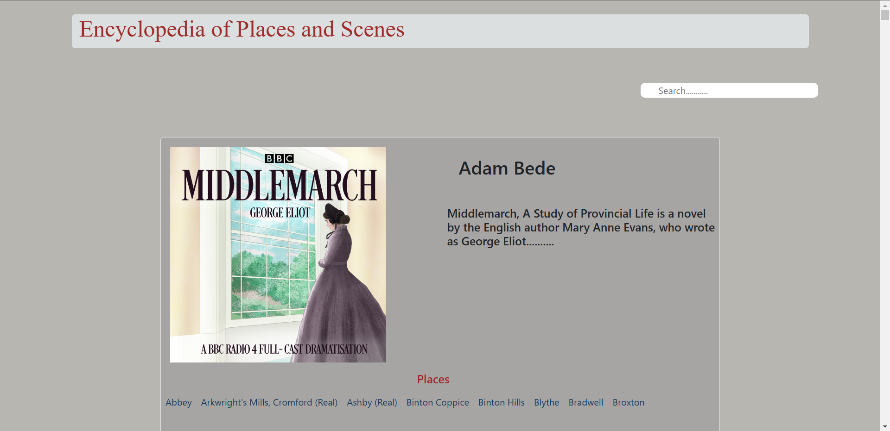

Some Images of the Website

Slide 4
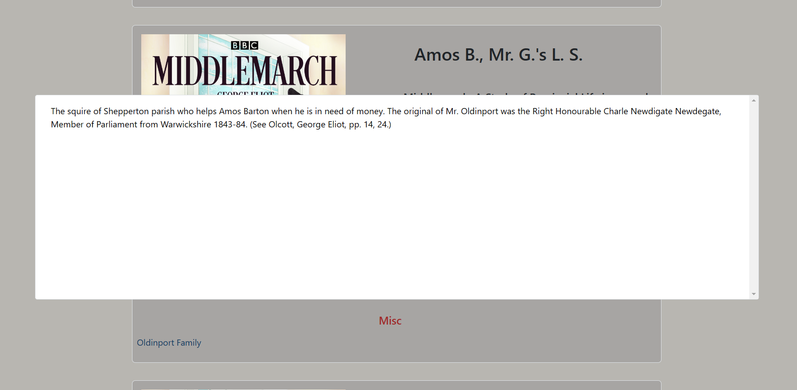
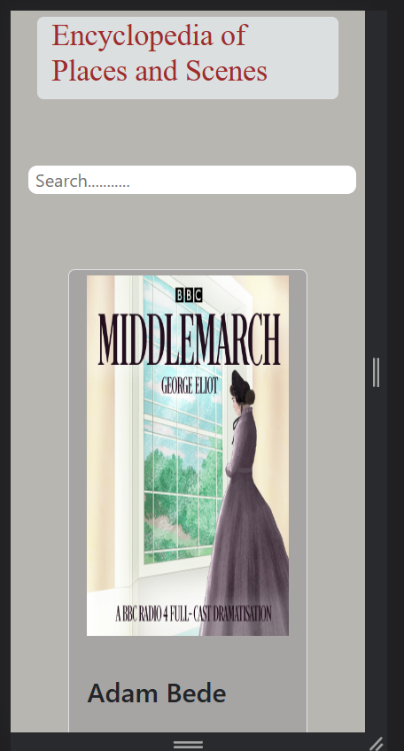
Some Images of the Website

Slide 5
Future Steps
Push my code to git.
Work on the New Design
Gather data and generate a perfect json file

Slide 6
THANK YOU

